Slide 1
Customer Data Analysis

Slide 2
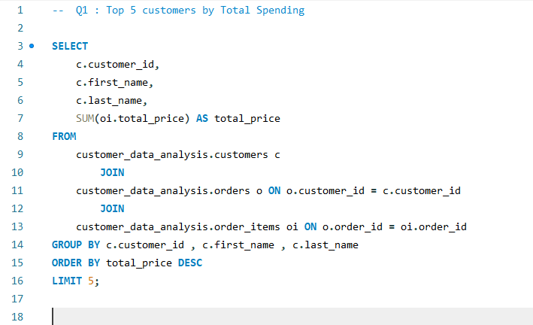
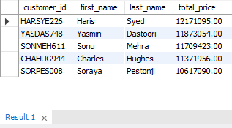
1. Top 5 Customers by Total Spending
MySQL Query
Its Result

Slide 3
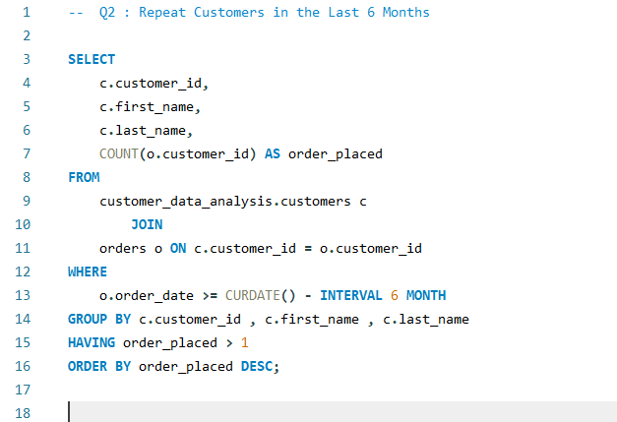
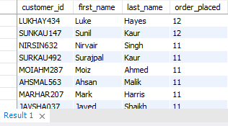
2. Repeat Customers in the Last 6 Months
MySQL Query
Its Result

Slide 4
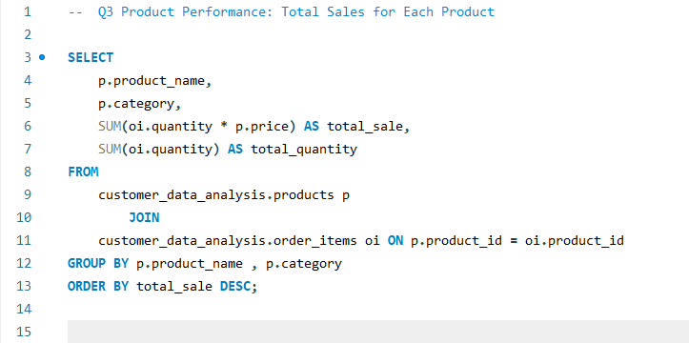
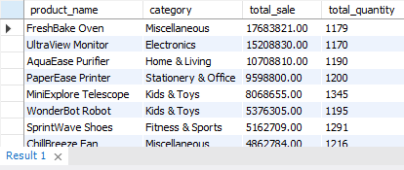
3. Product Performance: Total Sales for Each Product
MySQL Query
Its Result

Slide 5
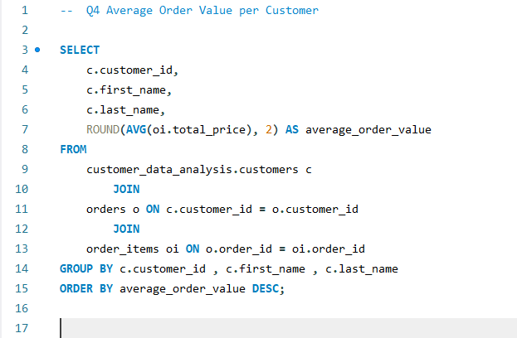
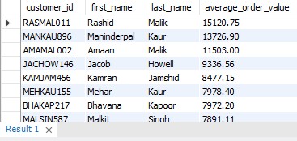
4. Average Order Value per Customer
MySQL Query
Its Result

Slide 6
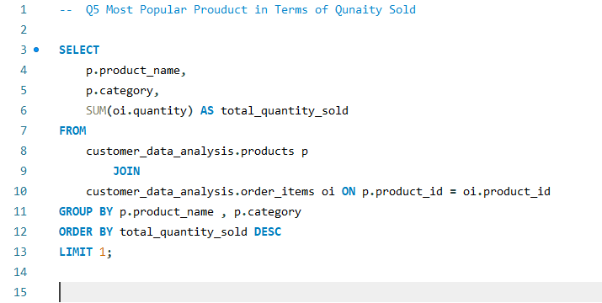
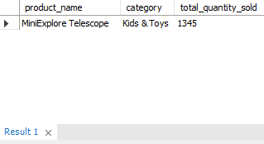
5. Most Popular Product in Terms of Quantity Sold
MySQL Query
Its Result

Slide 7
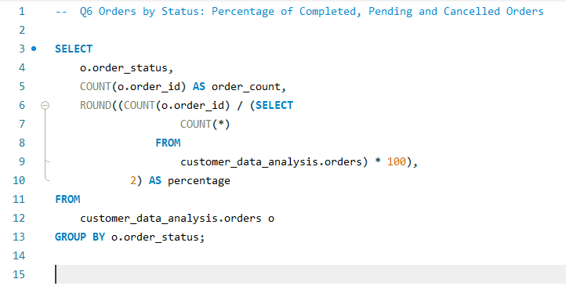
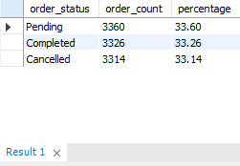
6. Orders by Status: Percentage of Completed , Pending and Pending Orders
MySQL Query
Its Result

Slide 8
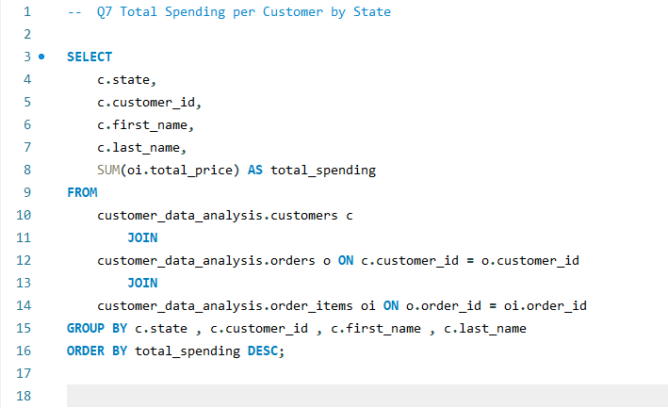
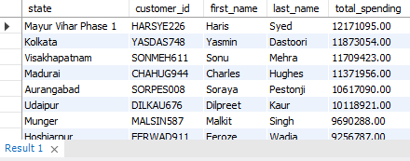
7. Total Spending per Customer by State
MySQL Query
Its Result

Slide 9
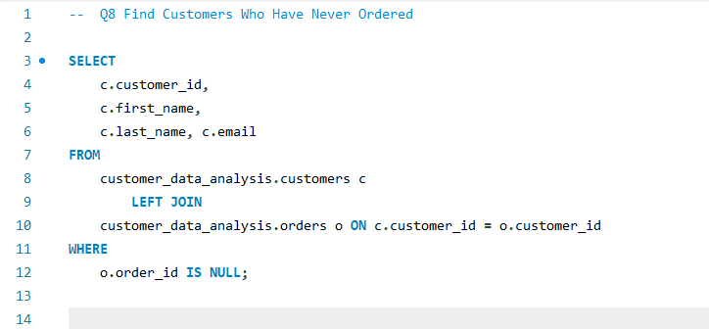
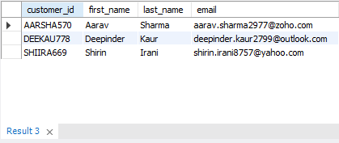
8. Find Customers Who Have Never Ordered
MySQL Query
Its Result

Slide 10
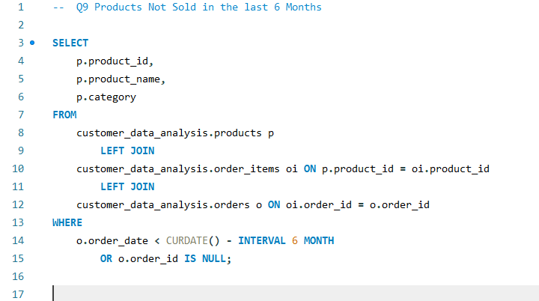
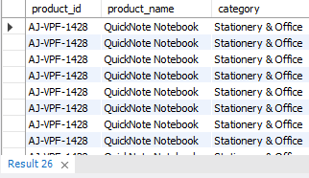
9. Products Not Sold in the Last 6 Months
MySQL Query
Its Result

Slide 11
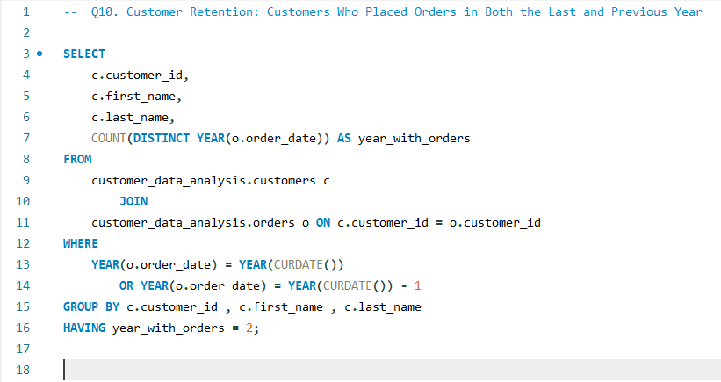
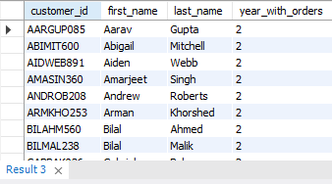
10. Customer Retention: Customers Who Placed Orders in Both the Last and Previous Year
MySQL Query
Its Result

Slide 12
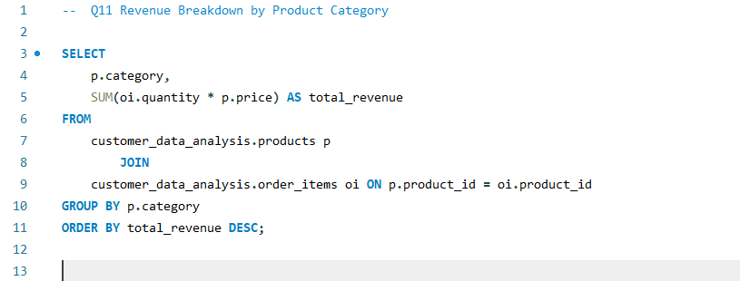
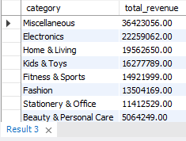
11. Revenue Breakdown by Product Category
MySQL Query
Its Result

Slide 13
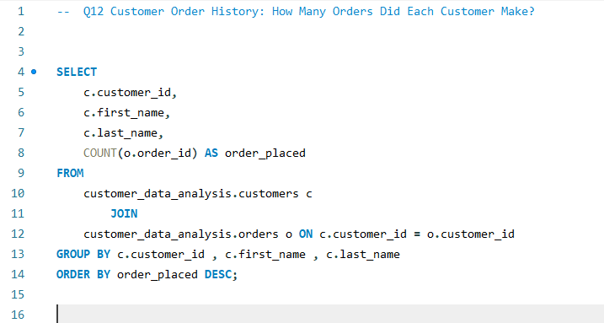
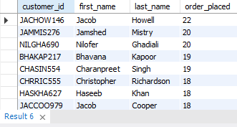
12. Customer Order History: How Many Orders Did Each Customer Make?
MySQL Query
Its Result

Slide 14
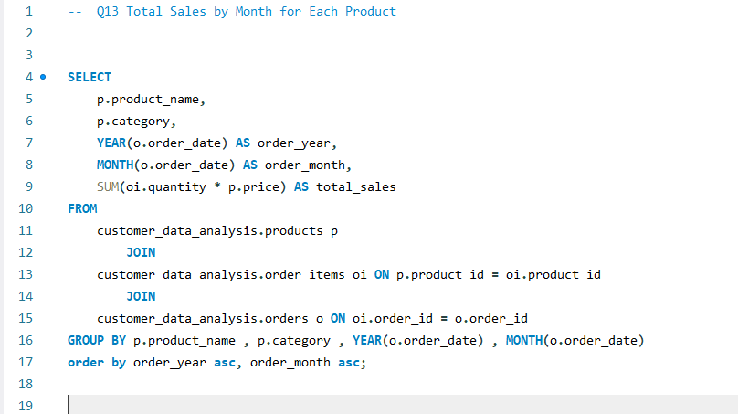
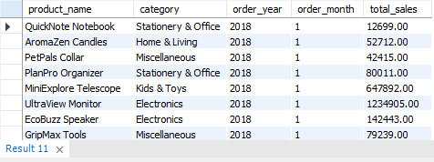
13. Total Sales by Month for Each Product
MySQL Query
Its Result

Slide 15
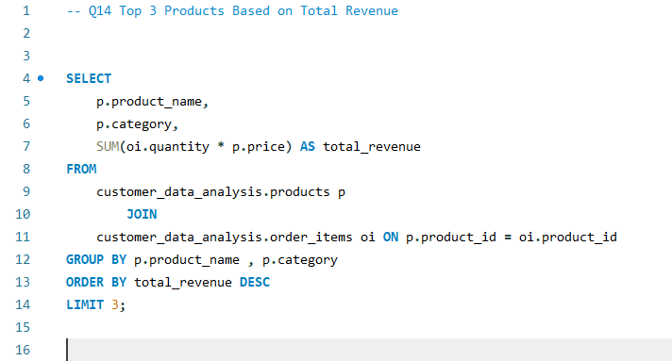
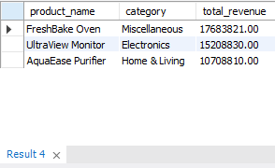
14. Top 3 Products Based on Total Revenue
MySQL Query
Its Result

Slide 16
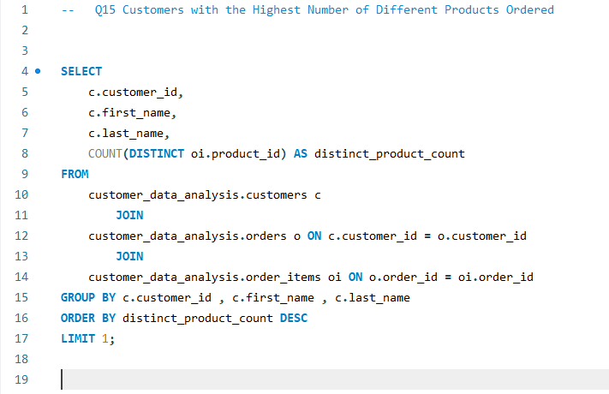
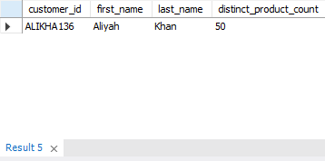
15. Customers with the Highest Number of Different Products Ordered
MySQL Query
Its Result

